Slide 1
Chapter 5
Hashing in Data structure
ITec2052:
Data Structure and Algorithme
by Serkalem.M
Arbaminch university
.

Slide 2
Introduction
Hashing is a well-known technique to search any particular element among several elements.
It minimizes the number of comparisons while performing the search
Hash: "From the French hatcher, which means 'to chop'. "
Hash Function: Take a large piece of data and reduce it to a smaller piece of data, usually a single integer.
  A function or algorithm
  The input need not be integers!
A hash table is an array of some fixed size, usually a prime number.

Slide 3
Advantage
Unlike other searching techniques,
Hashing is extremely efficient.
The time taken by it to perform the search does not depend upon the total number of elements.
It completes the search with constant time complexity O(1)

Slide 4
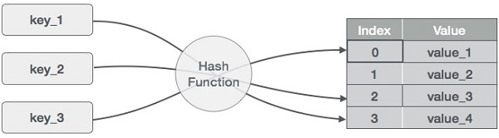
Hashing Mechanism…

Slide 5
Types of Hash Functions
There are various types of hash functions available such as
Mid Square Hash Function
Division Hash Function
Folding Hash Function etc
It depends on the user which hash function he wants to use

Slide 6
Properties of Hash Function
It is efficiently computable.
It minimizes the number of collisions.
It distributes the keys uniformly over the table.

Slide 7
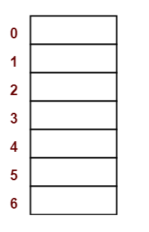
Example
Using the hash function ‘key mod 7’, insert the following sequence of keys in the hash table:
50, 700, 76, 85, 92, 73 and 101
Draw an empty hash table.
For the given hash function, the possible index range of hash values is [0, 6].
draw an empty hash table consisting of 7 buckets

Slide 8
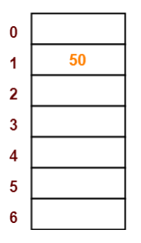
Example….
Insert the given keys in the hash table one by one.
The first key to be inserted in the hash table = 50.
Bucket of the hash table to which key 50 maps = 50 mod 7 = 1.
So, key 50 will be inserted in bucket-1 of the hash table

Slide 9
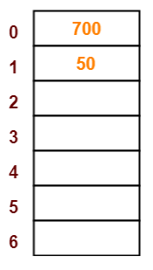
Example….
The next key to be inserted in the hash table = 700.
Bucket of the hash table to which key 700 maps = 700 mod 7 = 0.
So, key 700 will be inserted in bucket-0 of the hash table as

Slide 10
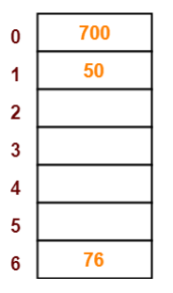
Example….
The next key to be inserted in the hash table = 76.
Bucket of the hash table to which key 76 maps = 76 mod 7 = 6.
So, key 76 will be inserted in bucket-6 of the hash table as:

Slide 11
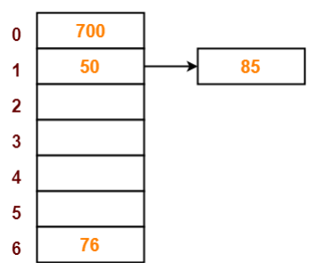
Example….
The next key to be inserted in the hash table = 85.
Bucket of the hash table to which key 85 maps = 85 mod 7 = 1.
Since bucket-1 is already occupied, so collision occurs.
Separate chaining handles the collision by creating a linked list to bucket-1.
So, key 85 will be inserted in bucket-1 of the hash table as:

Slide 12
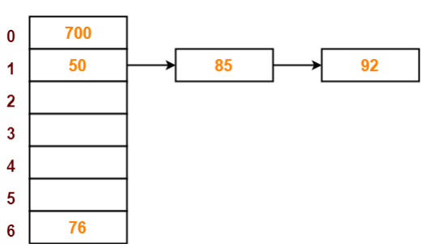
Example….
The next key to be inserted in the hash table = 92.
Bucket of the hash table to which key 92 maps = 92 mod 7 = 1.
Since bucket-1 is already occupied, so collision occurs.
Separate chaining handles the collision by creating a linked list to bucket-1.
So, key 92 will be inserted in bucket-1 of the hash table as:

Slide 13
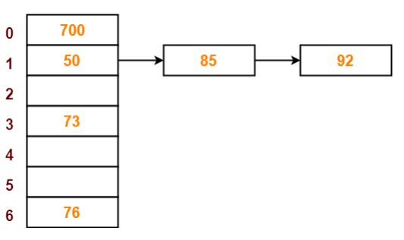
Example….
The next key to be inserted in the hash table = 73.
Bucket of the hash table to which key 73 maps = 73 mod 7 = 3.
So, key 73 will be inserted in bucket-3 of the hash table as:

Slide 14
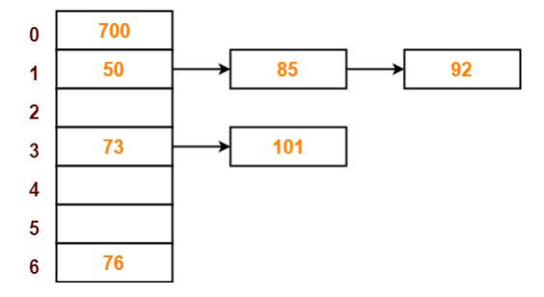
Example….
The next key to be inserted in the hash table = 101.
Bucket of the hash table to which key 101 maps = 101 mod 7 = 3. Since bucket-3 is already occupied, so collision occurs.
Separate chaining handles the collision by creating a linked list to bucket-3.
So, key 101 will be inserted in bucket-3 of the hash table as:

Slide 15
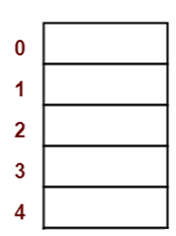
Class work 1
Using the hash function ‘key mod 5’, insert the following sequence of keys in the hash table:
chala, sara, , kuma, selam, and bekele
Draw an empty hash table.
For the given hash function, the possible index range of hash values is [0, 4].
draw an empty hash table consisting of 5 buckets

Slide 16
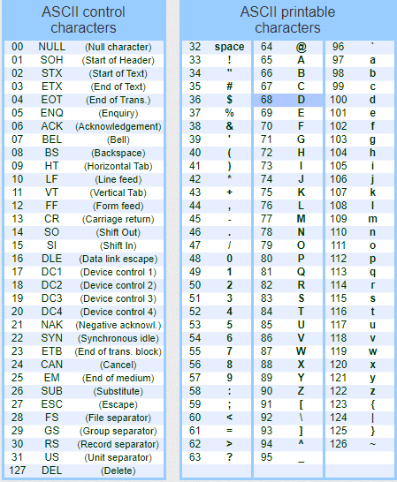
.

Slide 17
.
Collision occurs when hash value of the new key maps to an occupied bucket of the hash table.
A collision occurs when two different keys hash to the same value
Cannot store both data records in the same slot in array!
Two different methods for collision resolution:
  Separate Chaining: Use a dictionary data structure (such as a linked list) to store multiple items that hash to the same slot
  Closed Hashing (or probing): search for empty slots using a second function and store item in first empty slot that is found

Slide 18
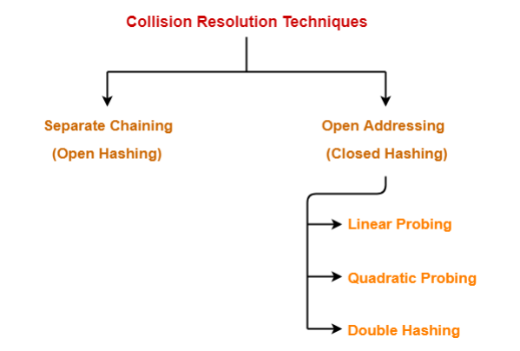
Collision Resolution technique

Slide 19
Separate chaining (open Hashing )
In chaining we use array indexes to store the values.
If hash code of second value also points to the same index then we replace that index value with an linked list and all values pointing to that index are stored in the linked list and actual array index points to the head of the linked list.
But if there is only one hash code pointing to an index of array then the value is directly stored in that index.

Slide 20
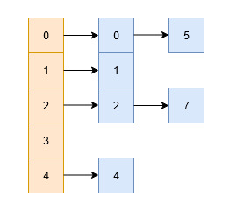
Example separate collision resolution
Suppose you wish to store a set of numbers = {0,1,2,4,5,7} into a hash table of size 5.
Now, assume that we have a hash function H, such that H(x) = x%5

Slide 21
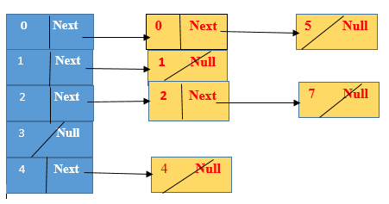
Collision resolution in separate chaining
In the chaining approach, the hash table is an array of linked lists i.e., each index has its own linked list
All key-value pairs mapping to the same index will be stored in the linked list of that index

Slide 22
Collision Resolution by Closed Hashing(Open Addressing)
In the open addressing collision resolution scheme, records with colliding keys are stored at other free locations in the hash table found by probing the table for open locations.
Different kinds of open addressing schemes use different probe sequences.
F is the collision resolution function. Some possibilities:
  Linear: F(i) = i
  Quadratic: F(i) = i²
  Double Hashing: F(i) = iHash₂(X)

Slide 23
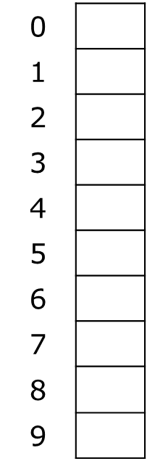
Open Addressing: Linear Probing
Example: insert 38, 19, 8, 79, 10
Note:- insert k(i) at the first free location
If h(key) is already full,
Try (location +i)% m
i= 0 to m-1
(u +i)%m
Index := hash(key)
While Table(Index) Is Full do
index := (index + 1) MOD Table_Size
if (index = hash(key))
return table_full
Else
Table(Index) := Entry

Slide 24
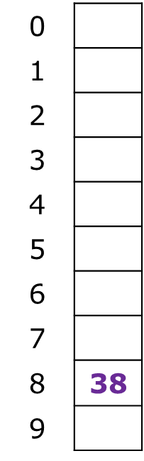
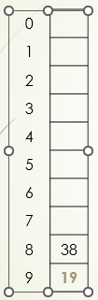
Open Addressing: Linear Probing example 1
Store directly in the array cell (no linked list or buckets)
Example: insert 38, 19, 8, 79, 10
If h(key) is already full,
Try (location +i)% m
i= 0 to m-1
(u +i)%m

Slide 25
Open Addressing: Linear Probing example 1
0 | 8
1
2
3
4
5
6
7
8 | 38
9 | 19
Store directly in the array cell (no linked list or buckets)
How to deal with collisions?
If h(key) is already full,
Try (location +i)% m
i= 0 to m-1
(u +i)%m
(8+0)%10………i is incremented

Slide 26
Open Addressing: Linear Probing example 1
Store directly in the array cell (no linked list or buckets)
How to deal with collisions?
If h(key) is already full,
Try (location +i)% m
i= 0 to m-1
(u +i)%m
(79+0)%10………i is incremented
0 | 8
1 | 79
2
3
4
5
6
7
8 | 38
9 | 19

Slide 27
Open Addressing: Linear Probing example 1
0 | 8
1 | 79
2 | 10
3
4
5
6
7
8 | 38
9 | 19
Store directly in the array cell (no linked list or buckets)
How to deal with collisions?
If h(key) is already full,
Try (location +i)% m
i= 0 to m-1
(u +i)%m
(10+0)%10………i is incremented

Slide 28
Class work 2
Insert using Open Addressing: Linear Probing
M=10
H(k)=2k+1
(location+i)%table size
14, 8, 13, 7, 6, 12,3,10 and 4

Slide 29
Closed Hashing(Open Addressing) II: Quadratic Probing
For quadratic probing, k(i) = i²:
If the collision occur use= (location+ i² ⁾ % TableSize
0th probe: (h(key) + 0) % TableSize
1st probe: (h(key) + 1) % TableSize
2nd probe: (h(key) + 4) % TableSize
3rd probe: (h(key) + 9) % TableSize
…
i^{th} probe: (h(key) + i²) % TableSize
Intuition: Probes quickly "leave the neighborhood"

Slide 30
Quadratic Probing Example 1
Table size is 10
The elements are (89, 18, 49, 58, 79)
(location+ i² ⁾ % TableSize
Then…
0th probe: (h(key) + 0) % TableSize
1st probe: (h(key) + 1) % TableSize
2nd probe: (h(key) + 4) % TableSize
3rd probe: (h(key) + 9) % TableSize
…
0
1
2
3
4
5
6
7
8
9

Slide 31
Quadratic Probing Example 1
TableSize = 10
insert(89)
insert(18)
insert(49)
insert(58)
insert(79)
79 % 10 = 9 collision!
(79 + 1) % 10 = 0 collision!
(79 + 4) % 10 = 3
0 | 49
1
2 | 58
3 | 79
4
5
6
7
8 | 18
9 | 89

Slide 32
Class work 3
Insert using Open Addressing: quadratic probing
M=10
H(k)=2k+1
keys ={14, 8, 13, 7, 6, 12,3,10 , 4}

Slide 33
Closed Hashing Hashing(Open Addressing) III: Double Hashing
Probe sequence:
Hash1 and hash 2
If the collision occur use=> H1(key) + i* H2(key)% Table size
(u+v *i)%m
  0th probe = h(k) mod TableSize
  1th probe = (h(k) + g(k)) mod TableSize
  2th probe = (h(k) + 2*g(k)) mod TableSize
  3th probe = (h(k) + 3*g(k)) mod TableSize
  . . .
  i^{th} probe = (h(k) + i*g(k)) mod TableSize
Note: We must make sure that g(key) cannot be 0

Slide 34
Open Addressing: Double Hashing example 1
M=6
H1(k)=k%m
H2(k)=5-(k%5)
If the collision occur use=> H1(key) + i* H2(key)% Table size
(u+v *i)%m
Keys= {14,8,21,2 ,7}

Slide 35
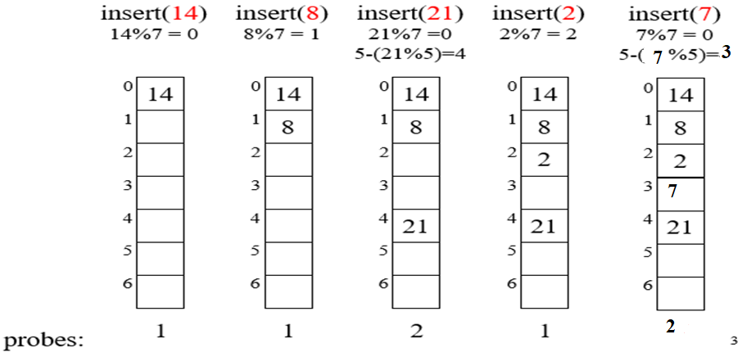
Open Addressing: Double Hashing example 1

Slide 36
Open Addressing: Double Hashing example 2
Insert using Open Addressing: quadratic probing
keys={14, 8, 13, 7, 6, 12,3,10 , 4}
M=10
H1(k)=2k+1
H2(k)=k+2
If the collision occur use=> H1(key) + i* H2(key)% Table size
(u+v *i)%m

Slide 37
Open Addressing: Double Hashing exercise
Keys= {3,22,27,40,42,11,19}
Tablesize = 10
H1(key)= key%10
H2(key)= 5-(key%5)
If the collision occur use=> H1(key) + i* H2(key)% Table size

Slide 38
Rehashing Example
Separate chaining
  h₁(x) = x mod 5 rehashes to h₂(x) = x mod 11
0
1
2
3
4
25
37
52
83
98
0
1
2
3
4
5
6
7
8
9
10
25
37
83
52
98

Slide 39

.

